Slide 1

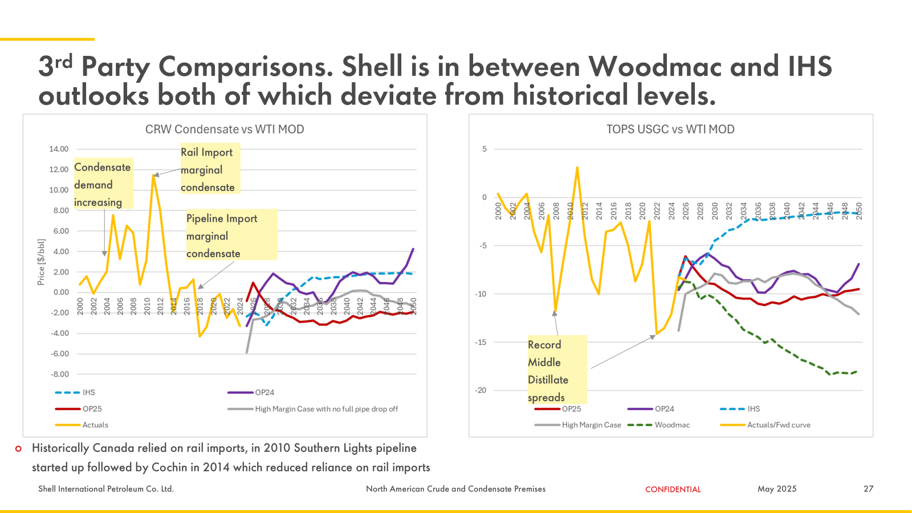
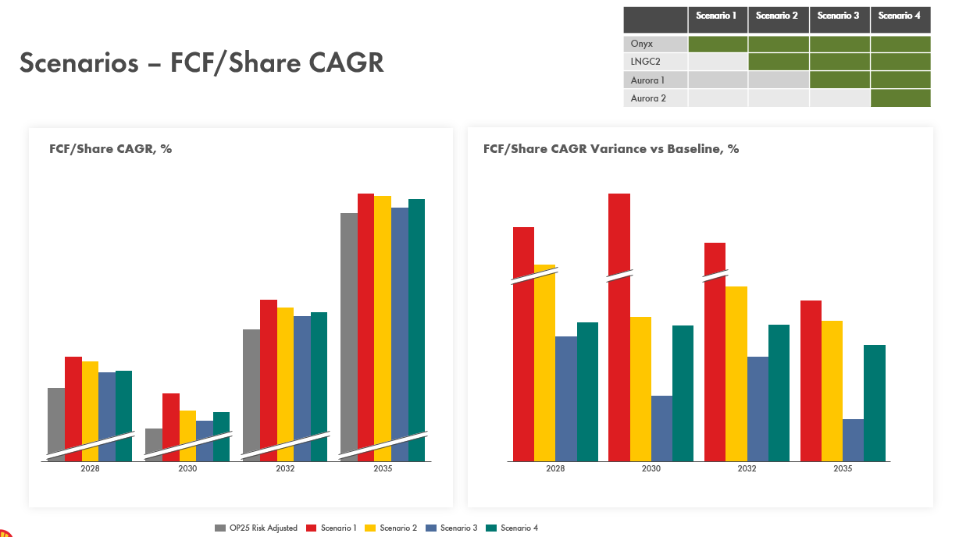
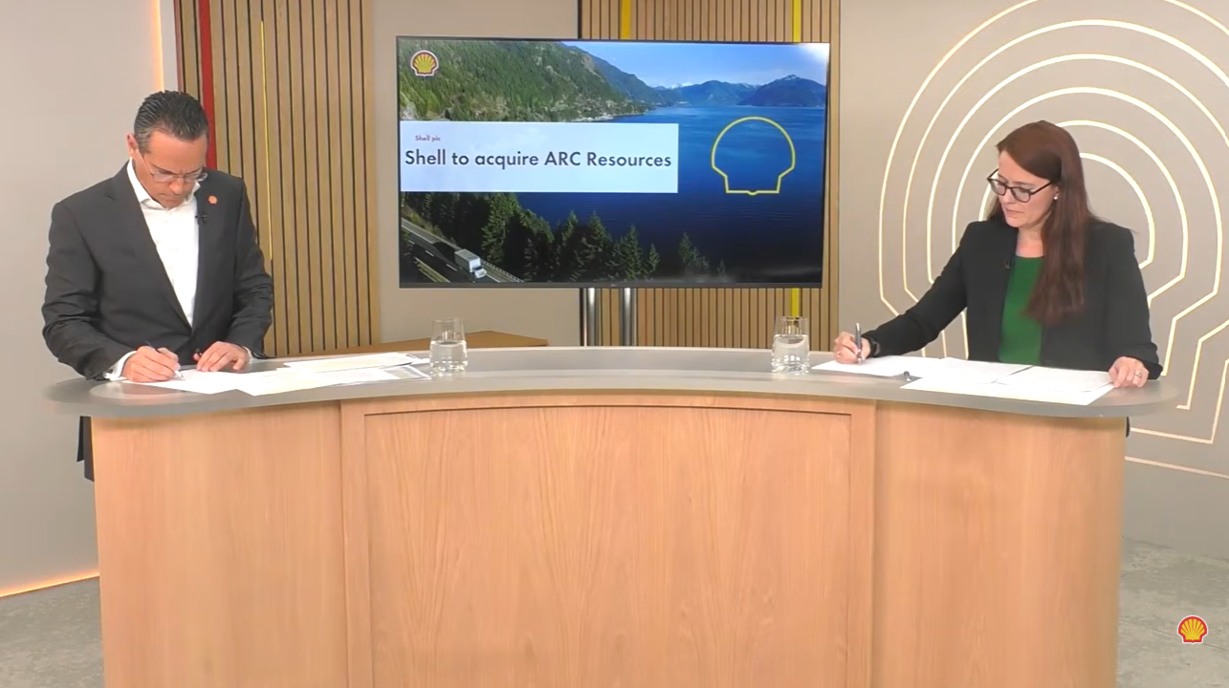
SHAPING GROUP DIRECTION
ARC RESOURCES ACQUISITION
How SCA supported the deal from market analysis through to announcement
SHAPE
CONNECT
ACCELERATE
Jonathan Bushman, Zhannat Dairova, Oswald Clint
SCA Global Team F2F 2026 | 7–8 September
$16.4bn
3+1
~2 months
0
Transaction value (USD),
including net debt
Three SCA teams working
as one with M&A
From mobilisation of SCA team to SPA signage
78 people signed up at announcement –zero leaks
01
MARKET FUNDAMENTALS
02
STRATEGIC PLANNING
03
INVESTOR RELATIONS
Shaping the value case
From Deal to Group value
Make the rationale travel
Diluent & NGL pricing: LPG (propane, butane) and gasoline (C5+) that come with ARC’s gas
Challenged the existing OCSVs assumptions
Worked with Shell Trading Canada, downstream strategy, Woodmac & S&P
15 years of history + forward curves to frame trends and price sensitivities
One integrated model - Group financial framework integrated with the M&A model, ensuring consistent fundamentals across both
Tested the portfolio choices beyond the deal across LNGC2 and Aurora to understand value under different scenarios
Stress-tested Group targets, funding, returns and balance-sheet impacts
Shaped the strategic narrative - why ARC, why now, and how it fits Shell’s direction
Translated the deal economics into a clear investor narrative
Benchmarked valuation against peers and precedent transactions
Anticipated a range of potential market reactions and prepared accordingly
GOVERNANCE WAS THE MULTIPLIER
1
2
3
4
Lean core team
Clear decisions
One working model
Tight confidentiality
Small group, high trust
Fast routes to decision makers
Shared models & analysis
Need-to-know access throughout
SCA + M&A worked as one team across modelling • negotiation • IR narrative
WHAT MADE IT WORK
01
02
03
Keep the team lean
Work together from the start
Challenge the assumptions
A small team made it easier to work through issues quickly and get decisions made.
SCA and M&A developed the analysis, negotiation approach and investor narrative together.
Internal expertise, external benchmarks and historical data helped test the key assumptions and sensitivities.
Shape. Connect. Accelerate.
September 7–8, 2026

